Slide 1
The right time to buy? Interest Rates and The Housing Market Delivery 2
Dan Cimiluca
Fall 2020
Notes:
Hi everyone - my name is Dan Cimiluca and this is delivery 2 for my capstone in data science at UMBC
My project is studying how interest rates can shift the housing market
And the hypothesis that I had starting this project was
Falling interest rates will lead to spikes in demand for homes, temporarily raising home values and create less favorable market conditions for buyers

Slide 2
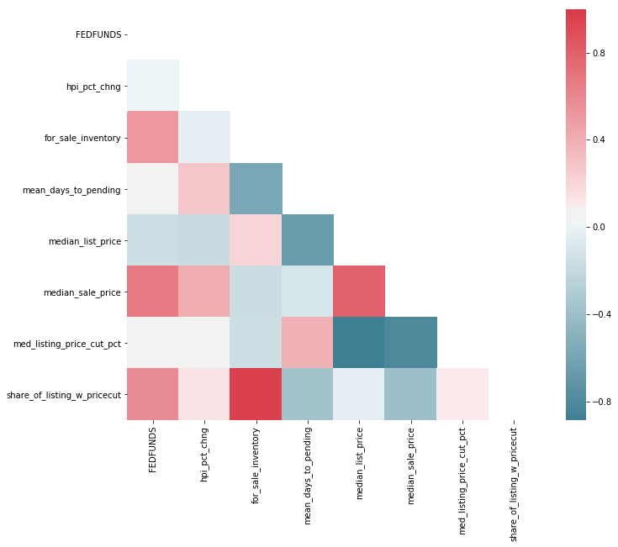
There is mixed evidence suggesting interest rates are negatively correlated with favorable buyer conditions
Noteworthy Negative Correlations
Month/Month Home Price Change
Median List Price
Noteworthy Positive Correlations
Median Sale Price
Share of listings with a price cut
Notes:
Wanted to start off by comparing the relationship between some housing market metrics and the fed funds rate

Slide 3
Started work on a “big picture” autoregression
model
Focused on country level metrics
Fed fund rate vs. Month/Month change in HPI
Key Assumption: Data must be stationary
Notes:
Data preparation for prototype, large scale model
Country level HPI, maybe one other metric….
Show graph of monthly HPI growth vs fed rate
Must check data is stationary:
A stationary dataset has the property that the mean, variance and autocorrelation structure do not change over time

Slide 4
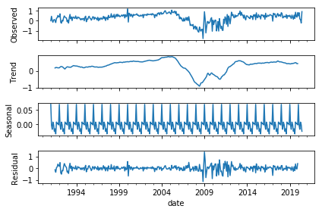
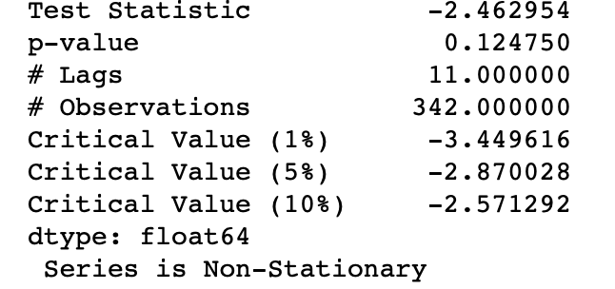
Home Price Data was not stationary
Ran seasonal decomposition over dataset
Performed Augmented Dickey-Fuller Test¹
Seasonality appears to be additive
Notes:
Performed a seasonal discomposure analysis
Looking at the trend you can see the data is not completely stationary, slight upward trend until around 2007 when the housing crisis kicked off and there's a downward trend until 2009, sharp increase in growth rate through 2014 and begins to stabilize
There's clearly seasonality to the data - peaks every few years but appears to be additive because the rate is not increasing over time
Residuals are fairly stable with the exception of 2009 and years following because of the housing crisis
Performed Augmented Dickey Fuller Test

Slide 5
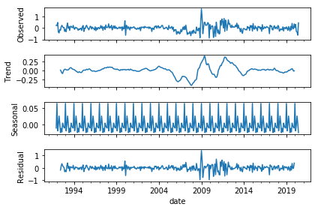
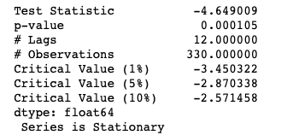
Transforming by the 12-month rolling average made the data stationary
Notes:
Decided to transform the data by the rolling 12-month average monthly change in home prices
I reran the seasonal discomposure analysis and you can see the variance in trend is much tighter
Performed Augmented Dickey Fuller Test

Slide 6
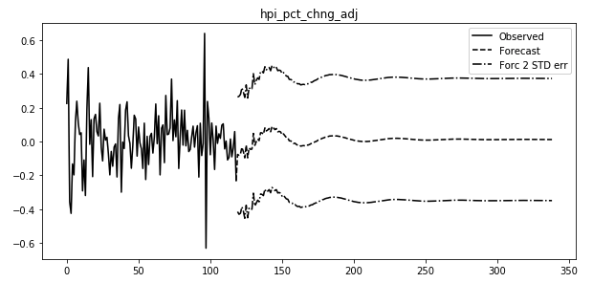
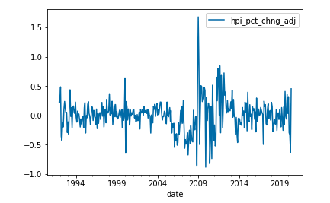
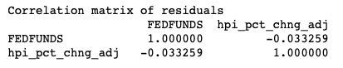
Autoregression model was trained on 10 years of performance
Graph of the model is shown below next to the actual transformed HPI metric
Notes:
Split the dataset into a training set, 10 years of data from 1992 - 2002 and trained the autoregression model using that
You can see a graph of the actual data vs model output below, with another chart showing the actual transformed data

Slide 7
Next steps/Ongoing work
Model results need to be transformed back to original state
Change train/test timeframes to incorporate time based cross validation
Incorporate additional metrics into models
Develop visualizations based on results
Notes:
Much more work to do
The example I showed for this presentation was is big picture
More analysis needs to be done to drill down locations impacted the most by rate changes (Region, state.. Things of that nature)
Change the training/testing timeframes to incorporate time based cross validation
Models need to be developed incorporating other factors and begin developing some visualizations based on results
Exciting to continue working on this

Slide 8
Thank you for watching!
For questions or comments I can be reached at: dcimilu1@umbc.edu

Slide 9
References
[1]: Alam, Mahbubul. ”Multivariate time series forecasting”. towards data science. April 2020.
https://towardsdatascience.com/multivariate-time-series-forecasting-653372b3db36. Accessed October 2020.

